Slide 1

§ 6.2 Addition & Subtraction of Fractions
addition means combining objects in two or
more sets
the objects must be of the same type, e.g. we
combine bundles with bundles and sticks with
sticks.
in fractions, we can only combine pieces of the
same size. In other words, the denominators
must be the same.

Slide 2





Addition of Fractions with equal denominators
Example:
1
+
3
(Remember: addition means combining objects.)
8
8
+
= ?
Click to see animation

Slide 3
Addition of Fractions with equal denominators
Example:
1
+
3
(Remember: addition means combining objects.)
8
8
+
=
Therefore the answer is
which can be simplified to
Many students believe that the answer should be
because it should be symmetrical. Are they correct?
Why or why not?

Slide 4
Addition of Fractions with equal denominators
Example:
1
+
3
(Remember: addition means combining objects.)
8
8
+
=
Let’s first check the answer with the pizza model.
which is smaller than the amount suggested by the above picture, so it is not correct.
The reason is that when we combine the pieces, the pieces stay at the same size, and the whole still has 8 pieces, not 16 pieces. Hence we should not add the denominators.

Slide 5
Addition of Fractions with equal denominators
Example:
1
+
3
(Remember: addition means combining objects.)
8
8
+
=
Another way to understand this is to treat the denominator as a unit.
The (1/8) is a “name” that tells us how big each piece is, such as (1/12) of a foot is called an “inch”, and (1/16) of a pound is called an “ounce”.

Slide 6
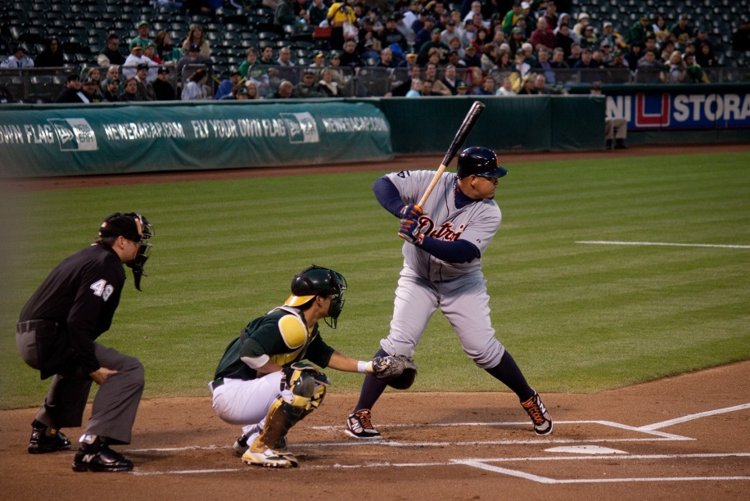
Baseball Arithmetic
In the first 10 games of the baseball season, Jim has 15 hits in 50 times at bat.
His batting average is 15/50.
In the next game he is at bat 6 times and gets 3 hits.
What is his new batting average?
Answer:
You should notice that we do add the denominator in this kind of arithmetic, because the whole (i.e. the total) is changing.

Slide 7
Addition of Fractions with equal denominators
More examples

Slide 8
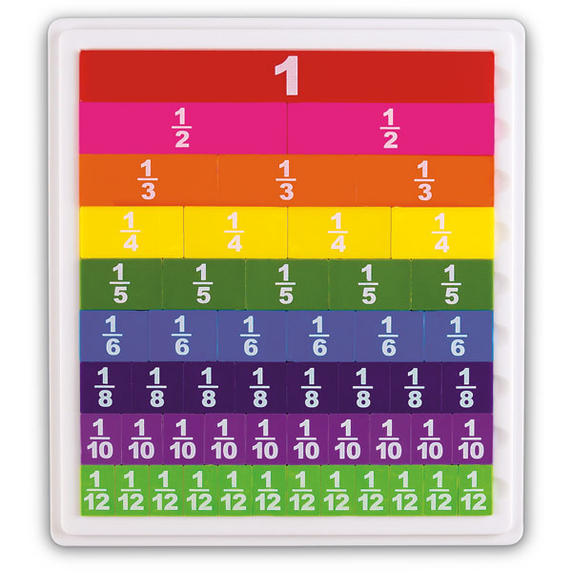
Fraction Tiles (also called Fraction Strips) are very useful in teaching fractions

Slide 9



Adding Fractions with different denominators
Add and using fraction tiles.
get the and fraction tiles.
find a common denominator, i.e. find a smaller tile that
can fit into and evenly.
find the total number of such tiles you use.
½
Therefore,

Slide 10
Addition of Fractions with
different denominators
We need to first convert them into equivalent fraction with the same denominator.
Example:
1
2
+
3
5
An easy choice for a common denominator is 3×5 = 15
1
1
×
5
5
2
2
×
3
6
=
=
=
=
×
5
5
×
3
3
5
15
3
15
Therefore,
1
2
5
6
11
+
=
+
=
3
5
15
15
15

Slide 11
Addition of Fractions with
different denominators
Remark: When the denominators are bigger, we need to
find the least common denominator by factoring.
If you do not know prime factorization yet, you have to multiply the two denominators together.

Slide 12
More Exercises:
3
1
3
×
×
+
3
1
4
9
4
9
4
13
1
+
=
+
=
+
=
=
=
1
4
3
4
×
×
3
3
4
12
12
12
12
12
3
2
3
×
×
+
=
7
2
5
=
21
10
=
21
10
31
+
+
+
=
5
7
5
×
×
7
7
5
35
35
35
35
5
4
5
×
×
=
9
4
6
=
45
24
+
+
+
6
9
6
×
×
9
9
6
54
54
45
+
24
69
15
=
=
=
1
54
54
54

Slide 13
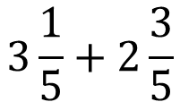
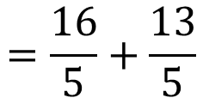
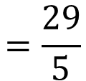
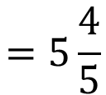
Adding Mixed Numbers (standard method)
Example:

Slide 14
Adding Mixed Numbers (alternative method)
1
3
1
3
Example:
3
+
2
=
3
+
+
2
+
5
5
5
5
1
3
=
3
+
2
+
+
5
5
1
+
3
=
5
+
5
4
=
5
+
5
4
=
5
5

Slide 15
Adding Mixed Numbers
Another Example:
4
3
4
3
2
+
=
+
+
+
1
2
1
7
8
7
8
4
3
=
2
+
+
+
1
7
8
4
×
+
×
8
3
7
=
3
+
56
53
53
=
3
+
=
3
56
56

Slide 16
Subtraction of Fractions
subtraction means taking objects away.
the objects must be of the same type, i.e. we
can only take away apples from a group of
apples.
- in fractions, we can only take away pieces of
the same size. In other words, the denominators
must be the same.

Slide 17
Subtraction of Fractions with equal denominators
11
3
Example:
−
12
12
This means to take away
3
from
11
12
12
11
12
take away
(Click to see animation)

Slide 18
Subtraction of Fractions with equal denominators
11
3
Example:
−
12
12
This means to take away
3
from
11
12
12
11
12

Slide 19

Subtraction of Fractions with equal denominators
11
3
Example:
−
12
12
This means to take away
3
from
11
12
12

Slide 20
Subtraction of Fractions with equal denominators
11
3
Example:
−
12
12
This means to take away
3
from
11
12
12
Now you can see that there are only 8 pieces left,
therefore
11
3
11
−
3
8
2
−
=
=
=
12
12
12
12
3

Slide 21
Subtraction of Fractions
More examples:
15
7
15
−
7
8
1
−
=
=
=
16
16
16
16
2
6
4
6
×
×
−
9
4
7
54
28
54
28
26
−
=
−
=
−
=
=
7
9
7
×
×
9
9
7
63
63
63
63
7
11
7
×
23
11
×
10
7
×
23
−
11
×
10
161
−
110
−
=
−
=
=
10
23
10
×
23
23
×
10
10
×
23
230
51
=
Did you get all the answers right?
230

Slide 22
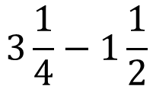
Subtraction of mixed numbers
This is more difficult than before, so please pay attention.
Example:
Since 1/4 is not enough to be subtracted by 1/2, we better convert all mixed numbers into improper fractions first.
1
1
3
×
+
×
+
4
1
1
2
1
3
−
1
=
−
4
2
4
2
13
3
=
−
4
2
13
6
=
−
4
4
7
3
=
=
1
4
4

